Slide 1
SNF Deficiency Mitigation

Slide 2


Benjamin Bartoszek
Senior HRIS Analyst

Slide 3
Deficiencies & Civil Monetary Penalties
1

Slide 4
When a skilled nursing facility fails to comply with regulations set by Centers for Medicare and Medicaid Services, the facility receives a deficiency citation. Each deficiency is assigned a scope letter based off of the matrix below.
 | Scope
Severity | Isolated | Pattern | Widespread
Immediate jeopardy to resident health or safety | J* | K* | L*
Actual harm that is not immediate jeopardy | G | H* | I*
No actual harm with potential for more than minimal harm that is not immediate jeopardy | D | E | F*
No actual hard with potential for minimal harm | A | B | C
*Indicates substandard quality of care

Slide 5
Civil Monetary Penalties
A monetary penalty the Centers for Medicare & Medicaid services imposed on a skilled nursing facility that is out of compliance.
Range from $50 to $10,000 per day out of compliance
Increase with scope from A - L
Significantly increase if deficiency is classified as substandard quality of care

Slide 6
Analysis
2

Slide 7

Linear Regression Model
Estimating CMP fine amounts based on:
Number of substandard care deficiencies
Number of not substandard care deficiencies
Size of facility based on number of licensed beds
Year
Ownership type
Overall star rating
CMS regional office location

Slide 8
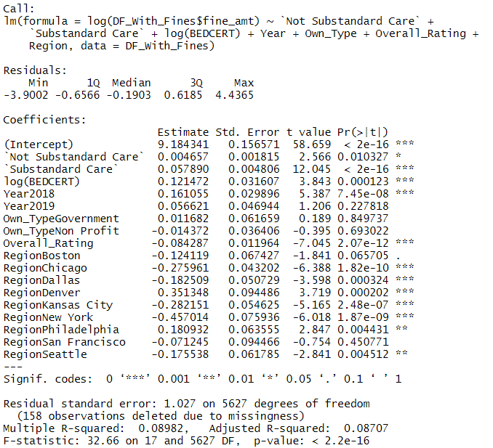
CMP fine estimate increases with:
Each deficiency received (both types)
Number of licensed beds
Year
Ownership type Government
CMS Regional offices in:
Atlanta
Denver
Philadelphia

Slide 9
Findings
3

Slide 10
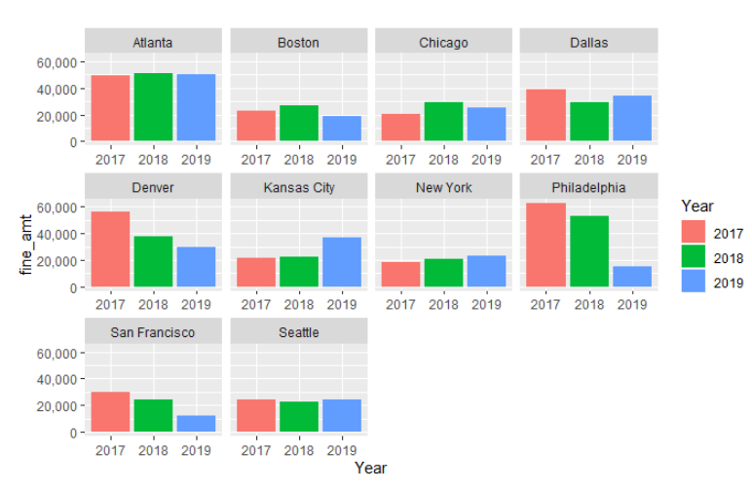
Average CMP fine amount by provider for each CMS regional location
White
Is the color of milk and fresh snow, the color produced by the combination of all the colors of the visible spectrum.
Higher fines per provider are visible in:
Atlanta
Denver
Philadelphia

Slide 11
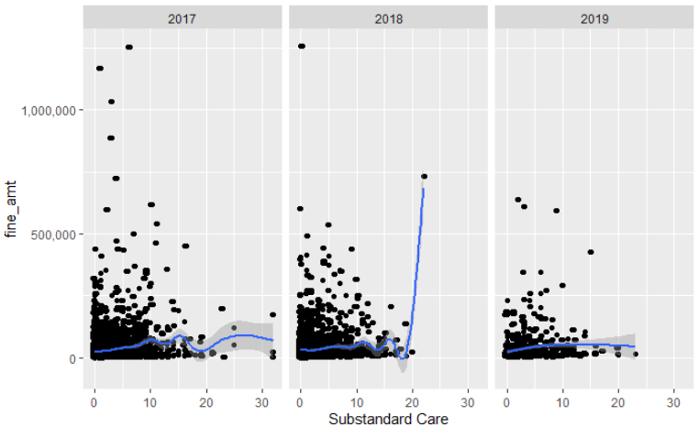
CMP fine amount by number of Substandard Care Deficiencies
White
Is the color of milk and fresh snow, the color produced by the combination of all the colors of the visible spectrum.
While there are some outliers, the general trend of CMP fine amount increases with the number of Substandard Care Deficiencies received.

Slide 12
CMP fine amount by number of Licensed Beds
White
Is the color of milk and fresh snow, the color produced by the combination of all the colors of the visible spectrum.
While there are some outliers, the general trend of CMP fine amount increases with the number of Licensed Beds.

Slide 13

Recommendations
Sell or avoid purchasing facilities that fall into the CMS regional locations of Atlanta, Denver or Philadelphia
Purchase facilities with a smaller number of licensed beds
Implement an auditing process to try to reduce or eliminate future deficiencies

